Slide 1

NovaPay Fraud Detection
Ransford Nyarko

Slide 2

Problem Statement
NovaPay processes millions of transactions across across international borders and needs to to detect illegitimate/fraudulent activities in real-time
NovaPay’s Current Fraud Environment includes
Identity Theft and Account Takeover
Transaction and Money Laundering
Unauthorized Payments through Compromised User Accounts

Slide 3

Business Objective
Design a fraud detection model that:
Identifies fraudulent activity early in the transaction lifecycle
Maintains a false-positive rate below 0.5% for customer-facing blocking actions
Demonstrate measurable reduction in fraud losses
Produces explainable and auditable model output that support regulatory compliance and internal risk review

Slide 4
Dataset Overview
Data was derived from NovaPay’s internal database system and a total of 10,757 transactions across 32 features
Some features included (amount in USD, source currency, destination currency, IP Address, Home Country, internal risk score, device risk score, velocity bursts)
Fraud Cases made up 982 (9.13%) of the transactions
Model was trained on 80/20 split
Train set contained 8,605 transactions (675 fraud)
Test set contained 2,152 transactions (307 fraud)

Slide 5
Modeling
Benchmarked simple and complex models to balance performance and interpretability
Models evaluated
Logistic Regression
Random Forest
eXtreme Gradient Boosting (XGBoost)
Light Gradient Boosting Machine (LGBM)
Advanced Modeling Techniques to handle data-imbalance
Fine-Tuning
Artificial Sampling (SMOTE)
Undersampling

Slide 6
Model Comparison
Model | Precision | Recall | F1 | ROC-AUC
Logistic Regression | 96.64% | 93.31% | 0.95 | 0.98
Random Forest | 100% | 92.18% | 0.96 | 0.98
XGBoost_SMOTE | 99.30% | 92.51% | 0.96 | 0.98
LGBM_SMOTE | 83.37% | 93.16% | 0.88 | 0.97

Slide 7

Model Selection
XGBoost was selected because:
Prioritized fraud capture with high precision
Achieved a slightly higher recall, identifying more fraudulent transactions
Higher recall means reduced total fraud loss
Strong compatibility with SHAP explainability

Slide 8
Auditable Framework
Model Explainability is handled by a package known Shapley Additive exPlainations (SHAP)
Model decisions are explained using six standardized reason codes. Each reason code aggregates multiple low-level model features into a single business concept.

Slide 9
Reason Codes
RC01 – Destination Currency / Corridor Risk
Captures risk associated with the destination of funds and cross-border corridors
Contributing Features include destination currency, corridor risk
RC02 – Source Currency Risk
Captures risk related to the currency from which funds originate
Contributing Features include the source currency
RC03 – Home Country Risk Profile
Captures jurisdictional risk tied to the account’s registered country
Contributing Features include home_country

Slide 10
Reason Codes Cont’d
RC04 – Location/Geographic Inconsistency
Captures mismatch between expected and observed transaction location
Contributing Features include location mismatch and ip country
RC05 – Device / IP Trust Profile
Captures trustworthiness of device and network used for transaction
Contributing Features include ip address, ip risk, device trust score, new device
RC06 – Account Tenure & Transaction Behavior Pattern
Captures behavioral, temporal and lifecycle characteristics of the account
Contributing Features include account age, amount source, amount, fee, channel

Slide 11
Top Fraud Indicators
Destination Currency
Certain destination corridors show disproportionately high fraud exposure
Home Country Risk profile
Fraud risk varies significantly by account origin
Reflects jurisdictional and regional risk patterns
Source Currency Risk
Currency of funds provides strong contextual risk signals
Some currencies are more frequently associated with fraudulent activity
Device Trust score
Low device trust strongly correlates with fraud
Device Risk Signals
Elevated device risk flags contribute meaningfully to fraud detection

Slide 12
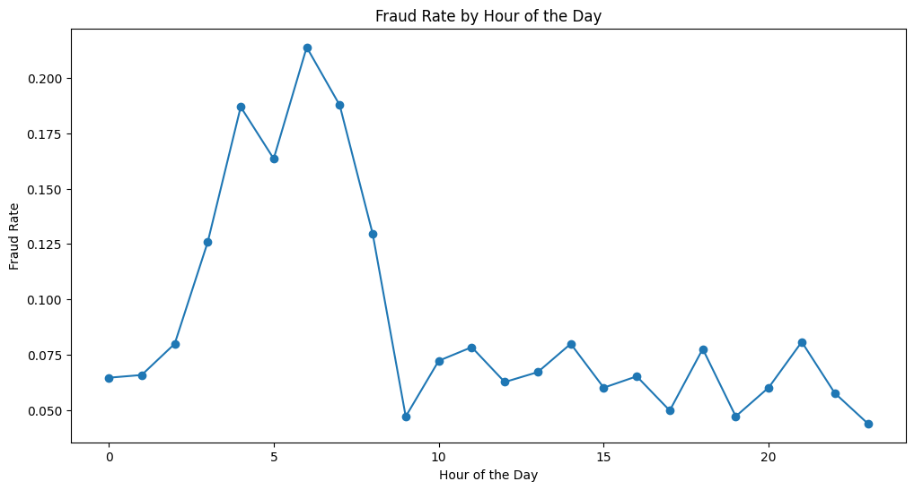
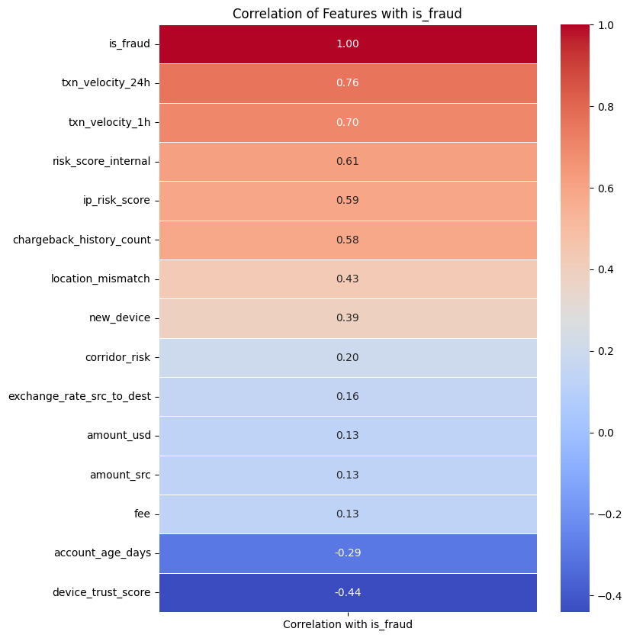
Key Business Insights
Fraud is driven by intraday behavior
Fraud risk peaks during early morning hours (3-7 AM, highest at 5-6 AM) and drops during standard business hours
Transaction velocity is a strong behavioral signal
Velocity within 24 hours (ρ = 0.76) and 1 hour (ρ = 0.70) shows the highest correlation with fraud. Internal risk score also correlates strongly (ρ = 0.61), reinforcing the importance of behavioral and velocity-based controls

Slide 13
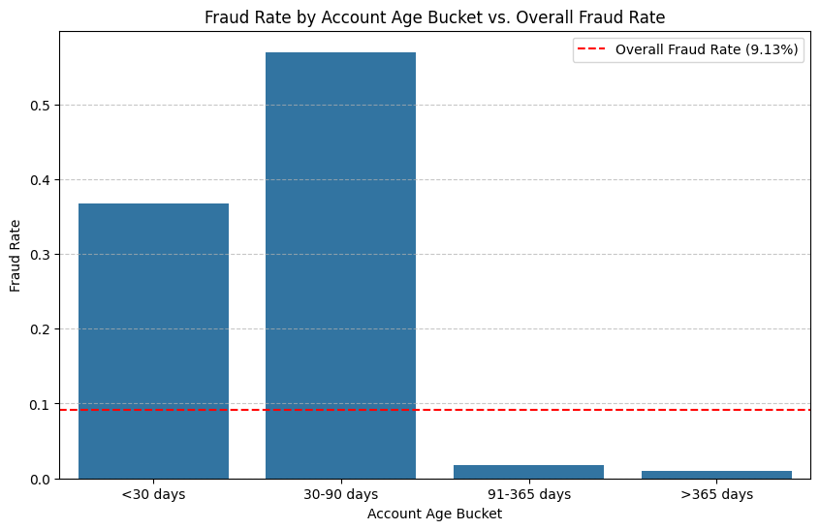
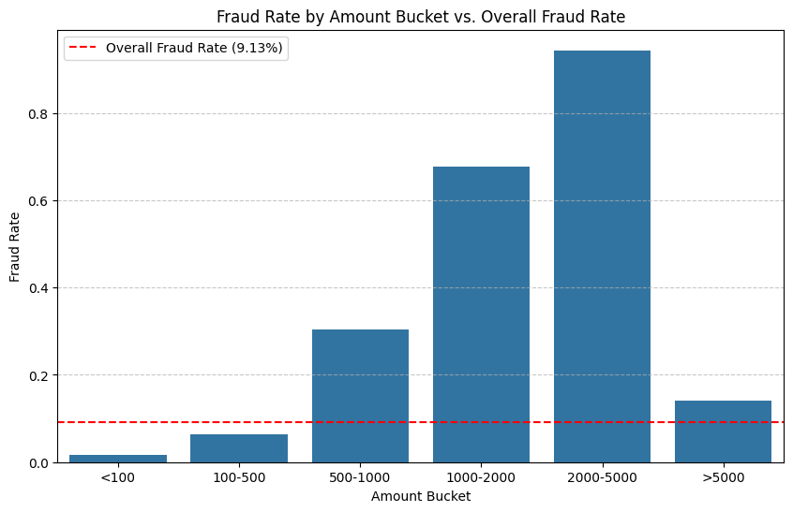
Key Business Insights Cont’d
Fraud risk is concentrated in early account life
Accounts within the first 90 days exhibit disproportionately high fraud rates, with risk declining sharply as accounts mature—indicating early-lifecycle targeting by fraudsters.
Fraud risk follows a non-linear relationship with transaction amount
Risk peaks in the $2,000–$5,000 range
IP risk score is a high-confidence discriminator
Fraud rates escalate rapidly once IP risk exceeds 0.7, making IP reputation a strong candidate for hard controls or step-up verification.

Slide 14
Recommended Controls
Apply stricter velocity limits for new accounts Prioritize enhanced controls during the first 90 days of account life, where fraud risk is most concentrated.
Introduce step-up verification for high-risk IP activity Trigger additional authentication or review when IP risk exceeds defined thresholds (e.g., >0.7).
Enhance monitoring during high-risk time windows Increase alert sensitivity and review coverage during early morning hours (3–7 AM), when fraud risk peaks.
Implement dynamic amount thresholds based on account age Apply lower transaction limits and stricter review criteria for high-value transactions on newly created accounts.

Slide 15
Production Readiness
Model Persistence
The final XGBoost model is serialized and versioned
Enables consistent inference without retraining
Explainability Persistence
SHAP explainer and SHAP values are saved alongside the model
Ensures explanations remain consistent with model behavior over time
Explainability Artifacts
Reason-code mappings and feature metadata are persisted
Supports transaction-level explanations, audits, and analyst review
Reproducible Pipeline
Training, preprocessing, evaluation, and explainability steps are fully reproducible
Model outputs can be regenerated deterministically from saved artifacts

Slide 16

Final Takeaway
Fraud risk is behavior-driven, not seasonal, and can be mitigated with targeted controls that preserve customer trus

